Slide 1
Historiographic Metafiction
‘...a self-conscious work of fiction concerned with the writing of history.’
(Nicol 2009: 99)
Historiographic
Metafiction
CMN260 Novel Ideas
Melanie Myers
Doctoral Candidate

Slide 2
Linda Hutcheon
A coin termed by
Historiographic
Metafiction
to describe postmodern historical fiction (1984).
‘HMF is fiction which uses metafictional techniques to ‘challenge assumptions behind literary realism’ and’ remind us that history is just a construction, not something natural that equates to the past.’
HMF
HMF
‘More than just a playful parody of history’ (?)
‘[A]s well as “explod[ing] realist narrative conventions” is still committed to telling a long
and involving story, full of believable characters, which can be enjoyed by the reader in the manner of nineteeth-century realism.’
HMF ‘ is at once didactic, teaching us about history, and also—at the same
time—allowing us the freedom to question, interpret,
even ‘co-write’ its narrative (in the Barthesian sense).’
‘Even though it destabilizes [sic] its own narrative, the fact is we can learn about real
historical events...’
(Nicol 2009: 99 – 106)
Notes:
Postmodern aesthetics: ‘the relationship between the real and that which seeks to represent the real.’ (Nicol 105)
Where the aim in view is the telling of a story, the problem of narrativity turns on the issue of whether historical events can be truthfully represented as manifesting the structures and processes of those met with more commonly in certain kinds of "imaginative"discourses, that is, such fictions as the epic, the folk tale, myth, romance, tragedy, comedy, farce, and the like. This means that what distinguishes "historical "from "fictional"stories is first and foremost their contents ,rather than their form. The content of his- torical stories is real events, events that really happened, rather than imaginary events, events invented by the narrator. This implies that the form in which his- torical events present themselves to a prospective narrator is found rather than constructed. (The Question of Narrative in Contemporary Historical Theory – Hayden White 1983, p. 3)

Slide 3
The Literary and the Historical both:
‘Historiography and fiction are both made up of narrative units (events, situations, utterances, and so on) which must be selected and ordered by a narrator, who is by definition partial, limited in the range of perspectives from which can he [sic]
can observe the narrative.’
(Nicol 2009: 101)
Historiographic
Metafiction
Derive their force/existence more from verisimilitude than objective truth
Are a linguistic construct (‘the recognition that language cannot refer to the real world, but only a conceptual version of it’ Nicol 2009: 103)
Use narrative form (history is only accessible via narrative or ‘texts’)
Rely on Intertextuality

Slide 4
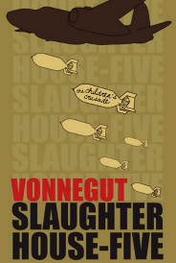
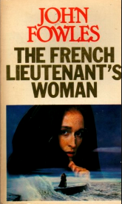
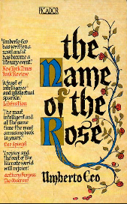

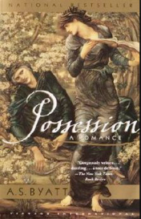
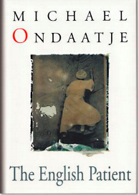
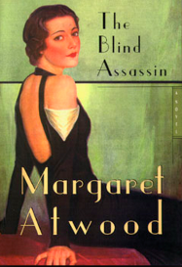
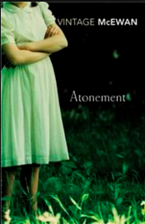
(Some) Works of Historiographic Metafiction
(1969)
(1969)
(1980)
(1984)
(1990)
(1992)
(2000)
(2001)
Notes:
Of all the modes of fiction associated with PM, HMF has been “best selling” as well as the subject of serious academic attention.
‘The acceptable face of PM in literary fiction’ – influenced by PM ideas about fictionality and its relationship with reality, but also popular with a general readership on a mass scale’ (Nicol p. 99)

Slide 5
Characterised by
Pastiche – a literary, musical, or artistic piece consisting of motifs or techniques
borrowed from one or more sources.
Self-reflexivity - marked by or making reference to its own artificiality or contrivance
‘...by intense self-reflexivity and overtly parodic textuality’
(Hutcheon 1995: 3)
Parody – a humorous or satirical imitation of a serious piece of literature of writing
Intertextuality -- the complex interrelationship between a text and other texts taken as
basic to the creation or interpretation of the text
Self-consciousness - done in a way that shows an awareness of the effect that
is produced : done in a deliberate way
Historiographic
Metafiction
Doubleness – presenting ‘a moment in history both as a vivid, believable representation
and [original emphasis] as a discursive, narrativized [sic] construct.’ (Nicol 2009: 103)
Notes:
Doubleness – the reader is made aware of the fictionality of the historical material in the text while at the same time remaining conscious of its basis in real events. p.103
HMF – ‘highlights the historian’s dependence on narrative’ p. 104

Slide 6
‘Parody and the Intextuality of History’ by Linda Hutcheon (1985)
Historiographic
Metafiction
‘The postmodern relationship between fiction and history is an even more
complex one of interaction and mutual implication. Historiographic Meta-
fiction works to situate itself within historical discourse without surrendering its autonomy as fiction. ... [t]he intertexts of history and fiction take on parallel (though not equal) status in the parodic reworking
of the textual past of both the “world” and literature. The textual incorporation of the intertextual past(s) as a constitutive structural element of post-modernist fiction functions as a formal marking of historicity-both literary and “worldly”.’
(Hutcheon 1985: 4)

Slide 7
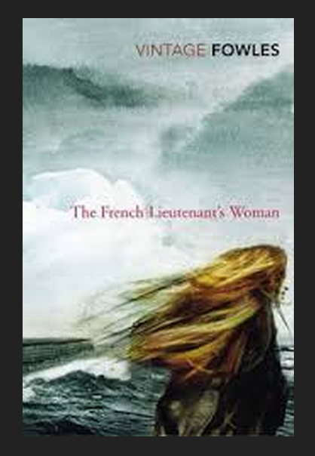
by John Fowles (1969)
The French Lieutenant’s Woman
‘... an extraordinarily effective pastiche of
nineteenth-century realist novel’
(Nicol 2009: 107)
And, also perhaps...
A work that has ‘not worn well’
(McCrum The Guardian 16 Aug 2015)
Notes:
Novel is beautifully constructed, with faultless replication of 19th century patterns of speech and period detail and rewards the kind of in-depth reading one might perform on a Hardy novel, noting the patterns of speech in the narrative and decoding its underlying symbolism
Fowles – TFLW ‘based on more or less disguised existential premises’ and tried ‘to show an existentialist awareness before it was chronologically possible’ (1990 p.51)
Satre – ‘human existence is pointless, as there is no inherent purpose to life and insists that one’s responsibility is therefore to determine the meaning of one’s life for oneself by making committed, responsible choices’ (Nicol 107)
Robinson – ‘extensive commentary has focused more on the metafiction than the historiography... In selectively representing the past as the anticipatory prehistory of the present, Fowles invents mid-Victorians who reflect the preoccupations of the 1960s. Through protagonists who are psychologically ahead of their time, he tries ‘to show an existential awareness before it was chronologically possible’ and likewise projects second-wave feminism back a century. (Robinson 121)
The novel’s engagement with the past is always critical and self-conscious (not merely the reflex mimicry of the past)
John Fowles(The French Lieutenant’s Woman), whose work has not worn well (Robert McCrum – The Guardian 16 August 2015)

Slide 8
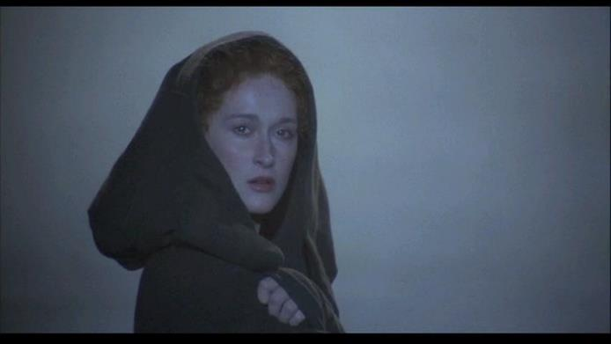
The French Lieutenant’s Woman
‘[T]he novel’s engagement with the past is always critical and self-conscious, and its
gripping narrative is accompanied by a carefully imposed metafictional framework
which enables Fowles to build in his strategies for composing the novel into the novel
itself.’
(Nicol 2009: 108)
Sarah Woodruff
‘She is ‘mythical’: she stands outside ‘history’ and outside fiction.’
(Waugh 1984: 125)
Notes:
‘blank parody’ – the reflex mimicry of the past (Nicol 108)
‘Even though it destabilizes its own narrative, the fact is that we can learn about real historical events from a work of HMF’ (Nicol 104)
* ‘Vision of a woman who ‘represented a reproach on the Victorian Age. An outcast. I didn’t know her crime, but I wished to protect her. That is when I began to fall in love with her. Or with her stance. I didn’t know which.’ (Robinson 124)

Slide 9
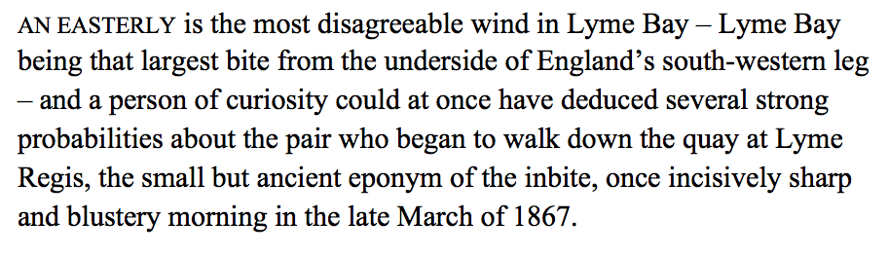
The French Lieutenant's Woman
Parody & Pastiche
‘[T]he nineteenth-century novel that century forgot to produce.’
(Conradi in Nicol 2009: 108)
(Fowles 1969: 1)
Fowles’s novel rehearses George Eliot in its intrusive moralization (sic). It rehearses Dickens
in its portrayal of characters like Charles’s manservant Sam. ... Hardy in it mysterious heroine.
Quotes from Marx, Linnaeus and Darwin provide a subtext for the drama. But always the
rehearsal is under the direction of Roland Barthes, or a French New Novelist, ... suggesting that
only if one is self-consciously aware that ‘history’ like ‘fiction’ is provisional, continually
reconstructed and open-ended can one make responsible choices within it and achieve a measure
of freedom.
(Waugh 1984: 125)

Slide 10

The French Lieutenant’s Woman

Slide 11
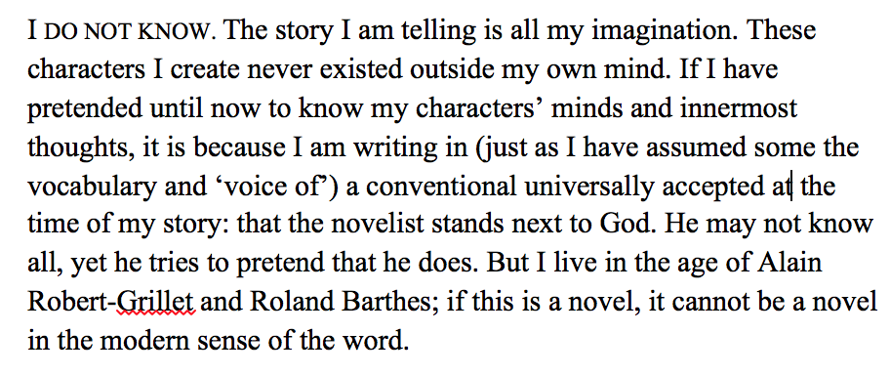
The French Lieutenant's Woman
Self-consciousness
A remarkable act of metafictional ‘frame-braking’. Chapter 13 notoriously begins:’
Roland Barthes – ‘The Death of the Author’ (1967)
(Fowles 1969: 103)
Alain Robert- Grillet -- Associated with the Nouveau Roman (new novel) trend.
‘We wish to create worlds as real as, but other than the world that is. Or was. (Fowles 1990: 98)
Notes:
First 12 chapters – reader has been able to immerse him/herself in the story, enjoying the kind of ‘suspension of disbelief’ required of realist novel (even though there are anachronistic reminders of the era in which the novel was composed rather than set.
The novel was well-defined by the 19th century. In the 20th century, however, many writers began to rebel against the traditional structures imposed by this form. This reaction against the novel caused some literary theorists to question the relevancy of the novel and even to predict its 'death.’
In the 1950s and 1960s, contributors to the discussion included Gore Vidal, Roland Barthes, and John Barth
Meanwhile Alain Robbe-Grillet argued that the novel would be likely to atrophy and die as a literary form if it did not advance beyond 19th century structures; this admonition led to his creation of the New Novel or Nouveau roman.^{[5]}
Asks questions about the degree of control an author can exercise over his fictional world.
Fowles ‘[t]he novelist is still a god, since he creates... What has changed is that we are no longer the gods of the Victorian image, omniscient and decreeing; but in the new theological image, with freedom our first principal, not authority.’ (1996, p. 109)

Slide 12
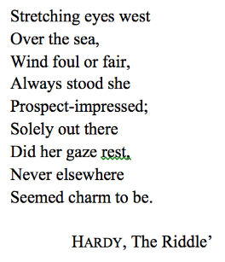

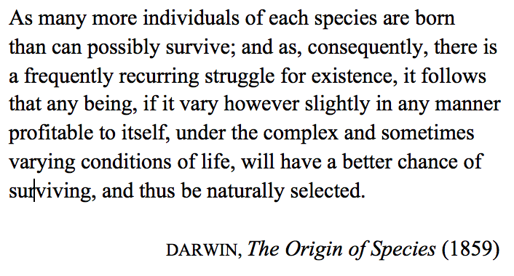
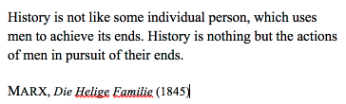
The French Lieutenant's Woman
Intextuality
Chap. 5 epigraph
Chap. 1 epigraph
Chap. 13 epigraph
Chap. 42 epigraph
‘...metafictional self-reflexivity (and intertextuality) renders their implicit claims to historical
veracity somewhat problematic, to say the least.’
(Hutcheon 1985: 3)
‘They were going to discuss whether the novel was dead or not. So it goes.’
(Vonnegut 1969: 169)
Notes:
Epigraph – an apposite (suitable, relevant, pertinent) quotation at the beginning of a book, chapter, etc.
Pursuit of freedom is played out on a collective scale, too, (as the novel’s epigraphs suggest) to the theme of Darwinian evolution

Slide 13
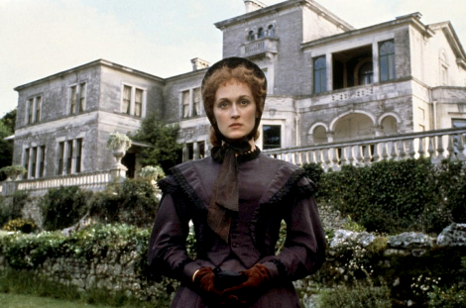
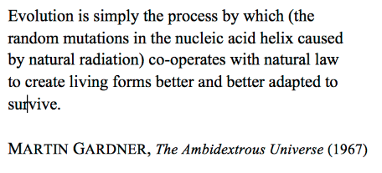
The French Lieutenant’s Woman
Intertextuality
Chap. 61 Epigraph
‘...metafictional self-reflexivity (and intertextuality) renders their implicit claims to historical
veracity somewhat problematic, to say the least.’
(Hutcheon 1985: 3)

Slide 14
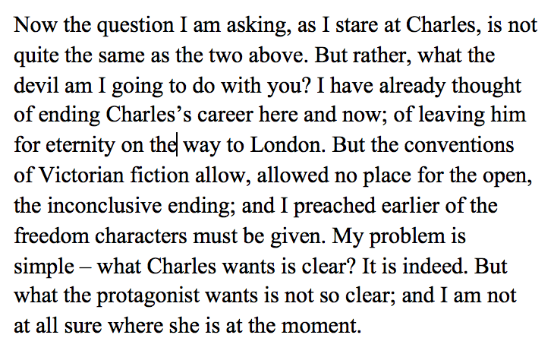
The French Lieutenant’s Woman
Doubleness &
Double-coded logic
(Fowles 1969: 451)
‘... a powerful critique of realism and an attempt to revitalize [sic] it. Its replication of a Victorian novel results in a text which is simultaneously a credible portrait of a historical portrait of a historical period and a self-reflective piece of artifice, referring both outside itself to the historical world and inside to its own workings.’
(Nicol 2009: 111)
Notes:
Forking paths principles
Four endings, but two are ‘ruled’ out by the author, yet because they have been described and remain in the book they still ‘exist’
Two ‘viable’ endings are presented, but ‘tyranny of last chapter’ remains prevails (the author’s choice?) – compromises the reader’s capacity to choose?
TFLW ‘a fascinating and valid analysis of the social and personal dilemmas faced by the Victorians: love, freedom, the emerging middle class. At the same time, its self-conscious textuality – its narratorial interventions, its epigraphs and multiple endings – reminds us that our knowledge of the 19th century is chiefly a literary one, as it is mainly constructed, just like Fowles’s own novel, from imaginative literature and historical texts. (p.112)

Slide 15
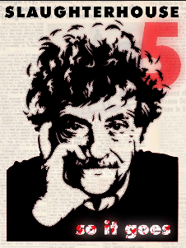
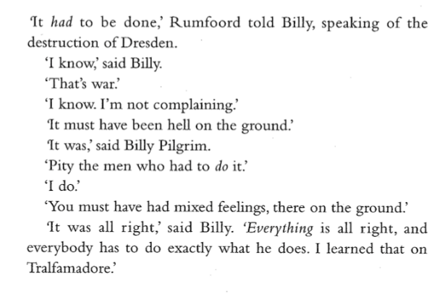
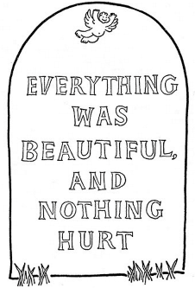
Slaughterhouse 5
Doubleness &
Double-coded logic
(p. 163)

Slide 16
Slaughterhouse 5
Doubleness &
Double-coded logic
‘Realism, it its suggested, ‘isn’t enough anymore’,
realism presents characters, but
There are almost no characters in this story and
almost not dramatic confrontations, because
most of the people in it are so sick and so much
the listless playthings of enormous forces. One of
the main effects of war, after all, is that people
are discouraged from being characters. (p.110)
Realism presents history as linear chronology, presents characters in terms of liberal humanism, allows for the possibility of free will and moral choice. But the novel implies that events like Dresden invalidate such liberal assumptions. They are revealed to be inadequate fictions which are possibly as much evasions of responsibility as the construction of Tralfamadorian kingdoms. (Waugh 1984:128)
Notes:
This doubleness is what leads to the emotional power of HMF. Not simply playful parody, making fun our our habit of believing in something which is patently fictional. Rather it affirms over and over again that history is crucial to our lives.

Slide 17
Slaughterhouse 5
Doubleness &
Double-coded logic
...Slaughterhouse-Five suggests that realism is an inadequate
means of portraying experiences like Dresden. Vonnegut
even breaks the the frame of the Dresden section by
appearing in it himself – ‘an old fart with his memories
and his pall malls’ (p.9). However, he cannot (nor does
his novel) embrace an aesthetic that ignores the
responsibility of literary fiction to engage with history,
with the temporal world.
Slaughterhouse-Five is more ‘real’ than Tralfamadore ...
[the novel] suggests that the construction of alternative
world ignores the events and logic of the historical world
but should provide an unfamiliar perspective on that world.
(Waugh 1984: 129)
Notes:
This doubleness is what leads to the emotional power of HMF. Not simply playful parody, making fun our our habit of believing in something which is patently fictional. Rather it affirms over and over again that history is crucial to our lives.

Slide 18

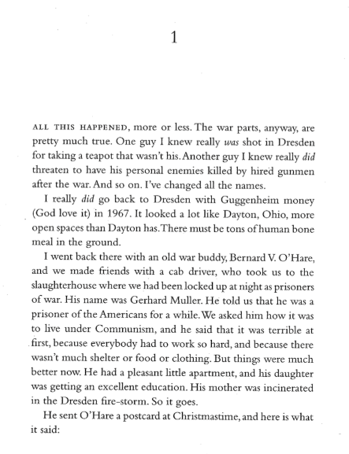
Slaughterhouse 5
Doubleness &
Double-coded logic
(p. 1)

Slide 19
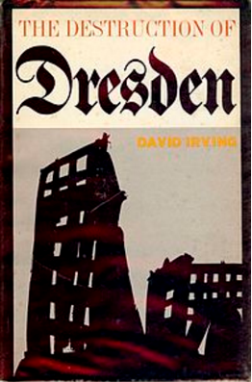
Slaughterhouse 5
Intertextuality
‘...focused historical attention in Europe and the US on the morality of the Allied bombing strategy designed to hasten the end of the war. Although the novel continually flaunts its fictional status, it still functions as a powerful record of what happened in Dresden 1944.’ (Nicol: 104)
‘...metafictional self-reflexivity (and intertextuality) renders their implicit claims to historical veracity somewhat problematic, to say the least.’
Notes:
SH5 – ‘makes clear that History is not some detached thing, like a great novel we read and are moved by; it is something that intervenes in our lives. The problem is how it does this and how we know what exactly happened in the past. Its accessibility may make it a more conservative form of PM writing, yet HMG nevertheless engages seriously with the one of the crucial dilemmas of PM aesthetics: the relation between the real and that which seeks to represent the real.

Slide 20
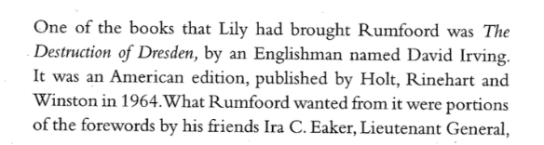
Slaughterhouse 5
Doubleness &
Double-coded logic
(p. 153)
‘The real death toll, which is terrible enough, is between 25,000 and 35,000. This number is based on the records (still in existence) kept at the time about the number of bodies recovered and cremated or buried’.
http://www.hdot.org/en/learning/myth-fact/dresden2.html

Slide 21
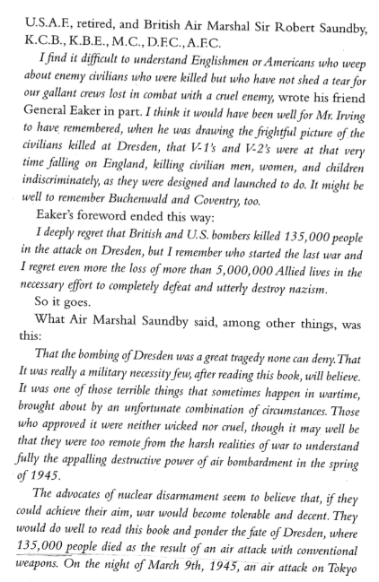

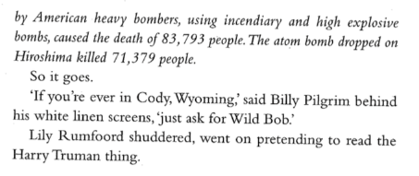
Slaughterhouse 5
Doubleness &
Double-coded logic
‘The real death toll, which is terrible enough, is between 25,000 and 35,000. This number is based on the records (still in existence) kept at the time about the number of bodies recovered and cremated or buried’.
http://www.hdot.org/en/learning/myth-fact/dresden2.html
(pp. 154 – 155)

Slide 22
References
Nicol, B 2009 The Cambridge Introduction to Postmodern Fiction, Cambridge
University Press, New York.
Fowles, J 1969 [1996], The French Lieutenant’s Woman, Vintage Books, London.
Hutcheon, L 1988 A Poetics of the Postmodern: History, Theory, Fiction, Routledge,
New York.
Hutcheon, L ‘Historiographic Metafiction Parody and the Intertextuality
of History’ in Intertextuality and Contemporary American Fiction. O'Donnell, P.
& Davis, R (Eds.) 1989, (3-32), Johns Hopkins University Press, Baltimore.
Hutcheon, L ‘Historiographic Metafiction: Parody and the Intertextuality of
History’ in Passionate Doubts: Designs of Interpretation in Contemporary American Fiction,
1995, pp. 3-32
Waugh P, 1984 Metafiction: The Theory and Practice of Self-Conscious Fiction,
Methuen, New York.
Vonnegut, K 1969 [2000], Slaughterhouse Five, Vintage Books, London.

